Slide 1
ROUTING PROTOCOLS
Notes:
ggggggggggggggggggggggggggggggggggggggggggggggg

Slide 2
Services Provided to the Transport Layer
Services independent of router technology.
Transport layer shielded from number, type, topology of routers.
Network addresses available to transport layer use uniform numbering plan
  even across LANs and WANs

Slide 3
Routing Algorithms (1)
Optimality principle
Shortest path algorithm
Flooding
Distance vector routing
Link state routing
Routing in ad hoc networks

Slide 4
Routing Algorithms (2)
Broadcast routing
Multicast routing
Anycast routing
Routing for mobile hosts
Routing in ad hoc networks

Slide 5
The Optimality Principle and Sink Tree
As a direct consequence of the optimality principle, the set of optimal routes from all sources to a given destination form a tree rooted at the destination. Such a tree is called a sink tree, where the distance metric is the number of hops. The goal of all routing algorithms is to discover and use the sink trees for all routers. A sink tree is not necessarily unique; other trees with the same path lengths may exist. If we allow all of the possible paths to be chosen, the tree becomes a more general structure called a DAG (Directed Acyclic Graph). DAGs have no loops.
Notes:
ggggggggggggggggggggggggggggggggggggggggggggggg

Slide 6
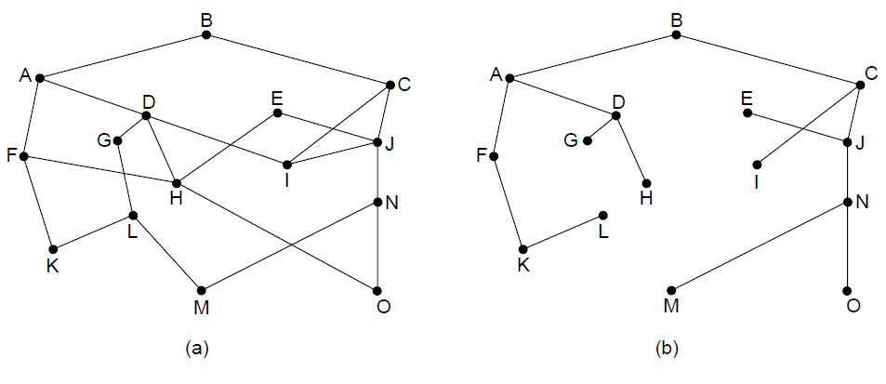
The Optimality Principle
(a) A network. (b) A sink tree for router B.

Slide 7
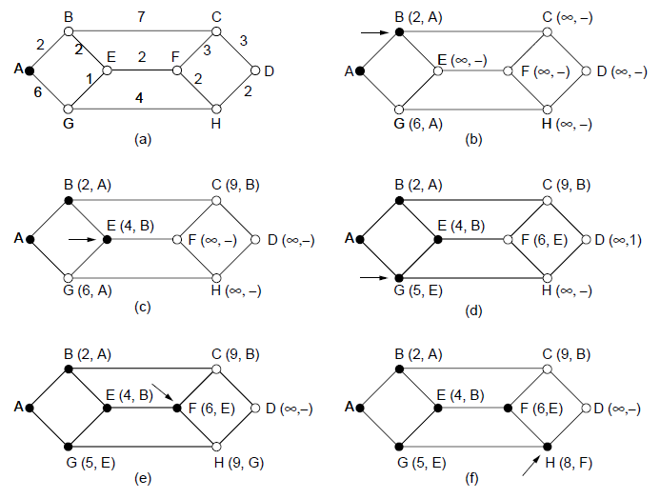
Shortest Path Algorithm (1)
The first five steps used in computing the shortest path from Routers A to D. The arrows indicate the working node

Slide 8
Shortest Path Algorithm (1)
The labels on the edges could be computed as a function of the distance, bandwidth, average traffic, communication cost, measured delay, and other factors. By changing the weighting function, the algorithm would then compute the ‘‘shortest’’ path measured according to any one of a number of criteria or to a combination of criteria. We start out by marking node A as permanent, indicated by a filled-in circle. Then we examine, nodes adjacent to A (the working node), relabeling each one with the distance to A. Whenever a node is relabeled, we also label it with the node from which the probe was made so that we can reconstruct the final path later. If the network had more than one shortest path from A to D and we wanted to find all of them. Having examined each of the nodes adjacent to A, we examine all the tentatively labeled nodes in the whole graph and make the one with the smallest label permanent, as shown above. This one becomes the new working node.

Slide 9
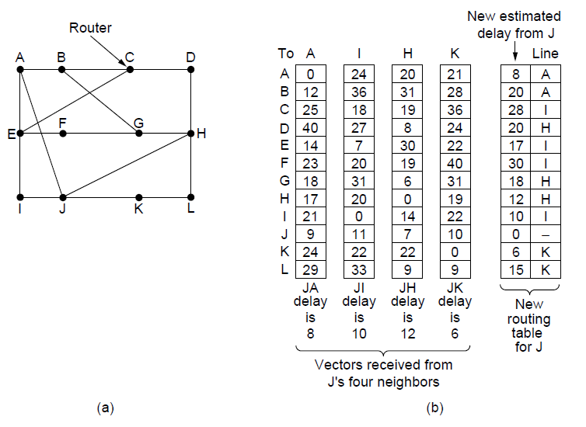
Distance Vector Routing
(a) A network. (b) Input from A, I, H, K, and the new routing table for J.

Slide 10
Distance Vector Routing
The router is assumed to know the ‘‘distance’’ to each of its neighbors. If the metric is hops, the distance is just one hop. If the metric is propagation delay, the router can measure it directly with special ECHO packets that the receiver just timestamps and sends back as fast as it can.
Updating process shows a network consisting of routers. The first four columns of part (b) show the delay vectors received from the neighbors of router J. A claims to have a 12-msec delay to B, a 25-msec delay to C, a 40 msec delay to D, etc. Suppose that J has measured or estimated its delay to its neighbors, A, I, H, and K, as 8, 10, 12, and 6 msec, respectively. Consider how J computes its new route to router G. It knows that it can get to A in 8 msec, and furthermore A claims to be able to get to G in 18 msec, so J knows it can count on a delay of 26 msec to G if it forwards packets bound for G to A. Similarly, it computes the delay to G via I, H, and K as 41 (31 + 10), 18 (6 + 12), and 37 (31 + 6) msec, respectively. The best of these values is 18, so it makes an entry in its routing table that the delay to G is 18 msec and that the route to use is via H. The same calculation is performed for all the other destinations, with the new routing table shown in the last column.

Slide 11
Link State Routing
Discover neighbors, learn network addresses.
Set distance/cost metric to each neighbor.
Construct packet telling all learned.
Send packet to, receive packets from other routers.
Compute shortest path to every other router.

Slide 12
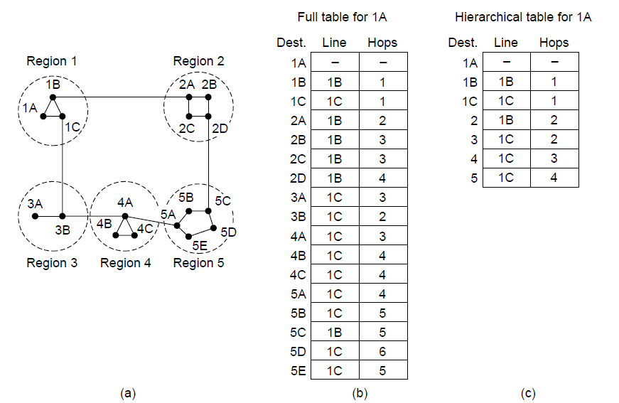
Hierarchical Routing

Slide 13
Hierarchical Routing
In hierarchical routing, routers are divided into regions. Each router knows all the details about how to route packets to destinations within its own region but knows nothing about the internal structure of other regions. When different networks are interconnected, it is natural to regard each one as a separate region to free the routers in one network from having to know the topological structure of the other ones. For huge networks, a two-level hierarchy may be insufficient; it may be necessary to group the regions into clusters, the clusters into zones, the zones into groups, and so on, until we run out of names for aggregations.
Kamoun and Kleinrock (1979) discovered that the optimal number of levels for an N router network is ln N, requiring a total of e ln N entries per router.

Slide 14
Broadcast Routing
One broadcasting method that requires no special features from the network is for the source to simply send a distinct packet to each destination.
Another broadcast routing technique is flooding.
Another one is multidestination routing, in which each packet contains either a list of destinations or a bit map indicating the desired destinations. When a packet arrives at a router, the router checks all the destinations to determine the set of output lines that will be needed. (An output line is needed if it is the best route to at least one of the destinations.) The router generates a new copy of the packet for each output line to be used and includes in each packet only those destinations that are to use the line. In effect, the destination set is partitioned among the output lines.

Slide 15
Broadcast Routing
In the method named reverse path forwarding when a broadcast packet arrives at a router, the router checks to see if the packet arrived on the link that is normally used for sending packets toward the source of the broadcast. If so, there is an excellent chance that the broadcast packet itself followed the best route from the router and is therefore the first copy to arrive at the router. This being the case, the router forwards copies of it onto all links except the one it arrived on. If, however, the broadcast packet arrived on a link other than the preferred one for reaching the source, the packet is discarded as a likely duplicate.
In the figure on next slide, on the first hop, I sends packets to F, H, J, and N, as indicated by the second row of the tree. Each of these packets arrives on the preferred path to I (assuming that the preferred path falls along the sink tree) and is so indicated by a circle around the letter. On the second hop, eight packets are generated, two by each of the routers that received a packet on the first hop. As it turns out, all eight of these arrive at previously unvisited routers, and five of these arrive along the preferred line. Of the six packets generated on the third hop, only three arrive on the preferred path (at C, E, and K); the others are duplicates. After five hops and 24 packets, the broadcasting terminates, compared with four hops and 14 packets had the sink tree been followed exactly.

Slide 16
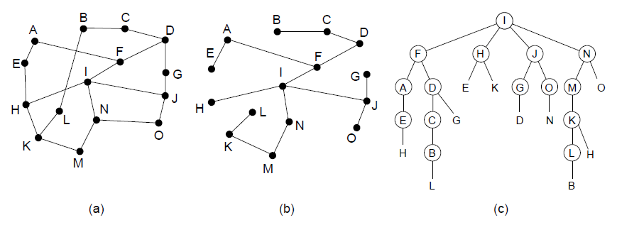
Broadcast Routing
Reverse path forwarding. (a) A network. (b) A sink tree.
(c) The tree built by reverse path forwarding.

Slide 17
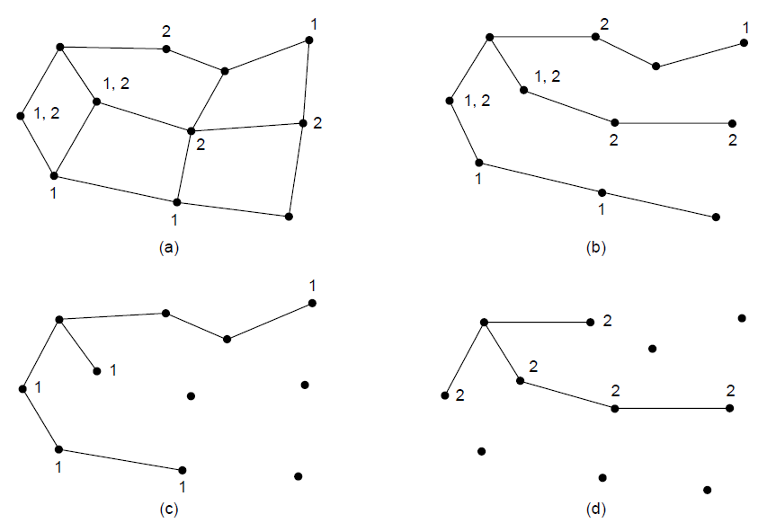
Multicast Routing (1)
(a) A network. (b) A spanning tree for the leftmost router. (c) A
multicast tree for group 1. (d) A multicast tree for group 2.

Slide 18
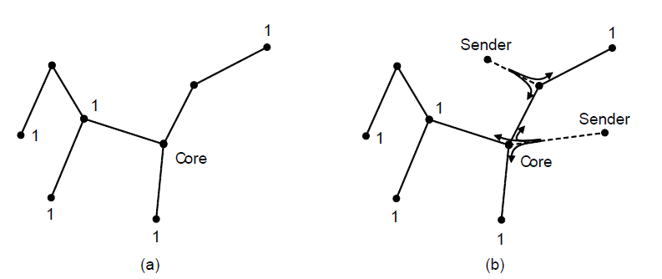
Multicast Routing (2)
Core-based tree for group 1.
Sending to group 1.

Slide 19
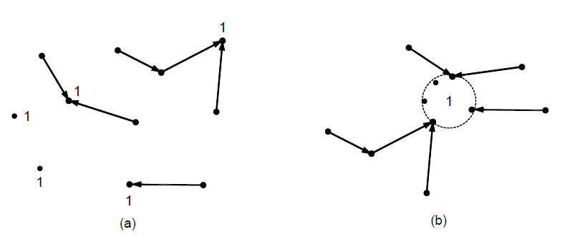
Anycast Routing
Anycast routes to group 1.
Topology seen by the routing protocol.

Slide 20
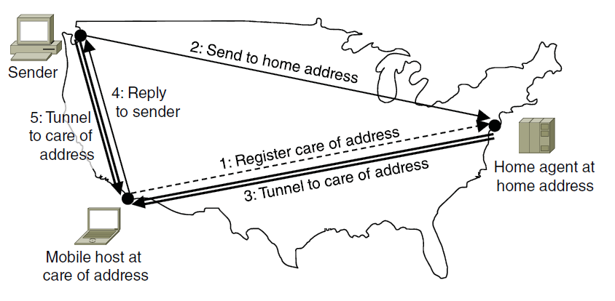
Routing for Mobile Hosts
Packet routing for mobile hosts

Slide 21
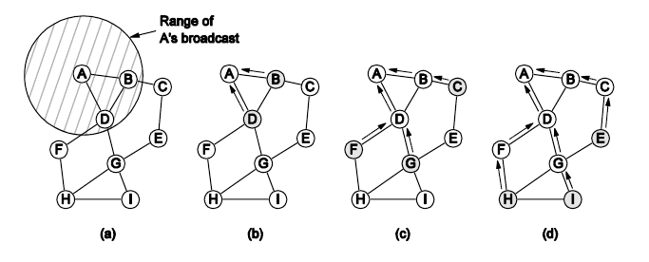
Routing in Ad Hoc Networks
The shaded nodes are new recipients. The dashed lines show possible reverse routes. The solid lines show the discovered route.
Range of A’s broadcast.
After B and D receive it.
After C, F, and G receive it.
After E, H, and I receive it.

